Slide 1
BR US Discount Sensitivity GBM model performance
March 2017

Slide 2
Data Used for VALIDATION & Observation
Feb 2014-
Jan 2015
Feb 2015-
Jan 2016
Behavior
Response and Score Validation
Mean and Median Ensemble are giving similar performance
We are picking median ensemble for obvious advantages

Slide 3
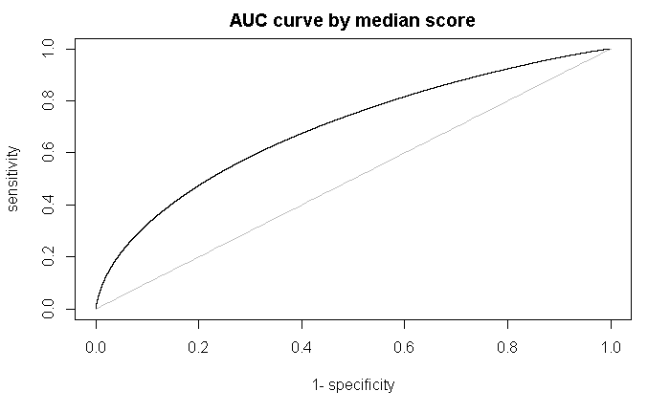

AUC Curve after ensemble
AUC by median ensemble 0.70
AUC by mean ensemble 0.70

Slide 4
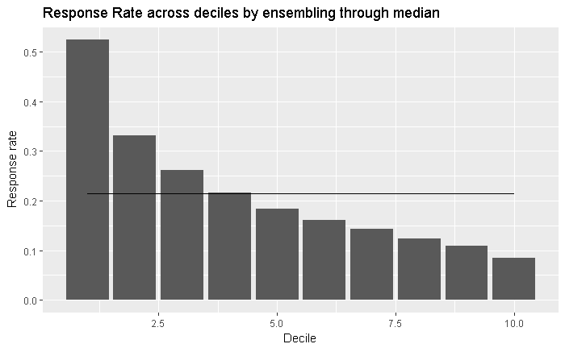

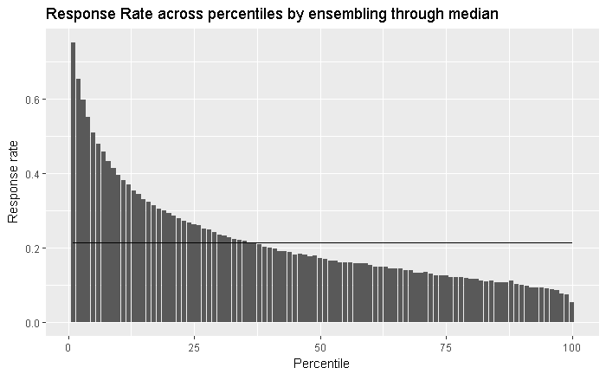
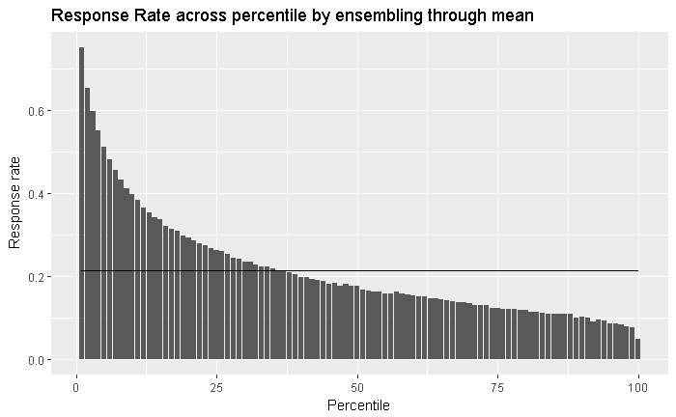
Response Rate Waterfall
Waterfall is well maintained
Response rate by decile/percentiles is higher than overall BAU response rate 0.1634871

Slide 5
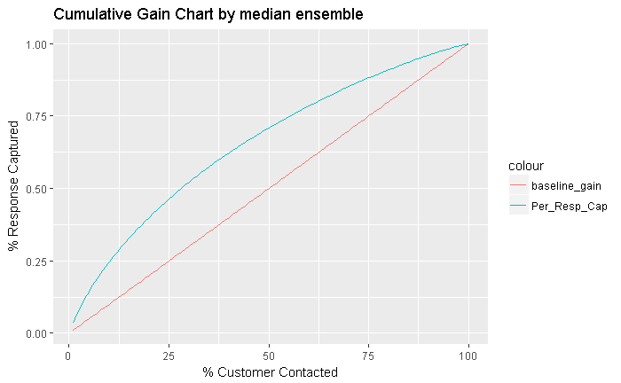
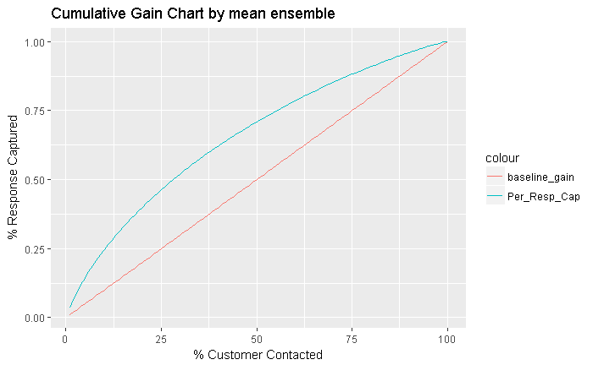
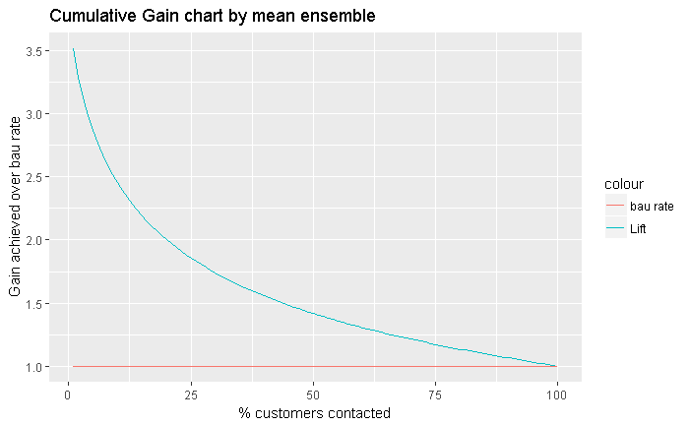
Cumulative Gain Chart and lift chart after ensemble
Overall BAU response rate 0.214064

